Slide 1
Long Short Term Memory
(LSTM)
STAT 469/563: Midterm

Slide 2
What is LSTM?
LSTM is a an advanced type of recurrent neural network (RNN) that can learn long-term dependencies between time steps of sequence data.
LSTMs are specifically engineered to address the vanishing gradient problem, which makes it difficult for standard RNNs to learn long-term dependencies in data.
LTSM Utilizes "gates" to retain both short-term and long-term memory.
Gates: Control the flow of information into and out of the memory cell.

Slide 3
Comparison to CNN ,DNN, RNN
Aspect | DNN | RNN | LSTM | CNN
Memory | No memory | Short-term memory | Long-term memory | No memory
Data Type | Static data | Sequential data | Sequential data | Grid-like data (e.g., images)
Flow | One-way (forward) | Feedback loops | Gated feedback loops | Local feature extraction
Use Case | General-purpose tasks | Time-series, text, speech | Long-term sequence tasks | Image/video analysis
Limitation | No sequential handling | Vanishing gradients | Computationally expensive | Limited to spatial data

Slide 4
Main Applications
Natural Language Processing (NLP): used for tasks like text generation, machine translation, sentiment analysis, and speech recognition.
Time Series Prediction: Excel at forecasting time-dependent data, such as stock prices, weather, or energy consumption.
Sequence Modeling: Used in video analysis, music generation, and other tasks where the order of data points matters.
Anomaly Detection: Identify unusual patterns in sequential data, such as fraud detection in financial transactions.

Slide 5
Why and When is LSTM Useful?
Long-Term Dependencies: LSTMs are useful when the relationship between data points spans long intervals (e.g., understanding context in a paragraph of text).
Sequential Data: LSTMs are ideal for data where the order of inputs is critical, such as time series or language.
Complex Patterns: LSTMs can capture intricate patterns in data that simpler models might miss.

Slide 6
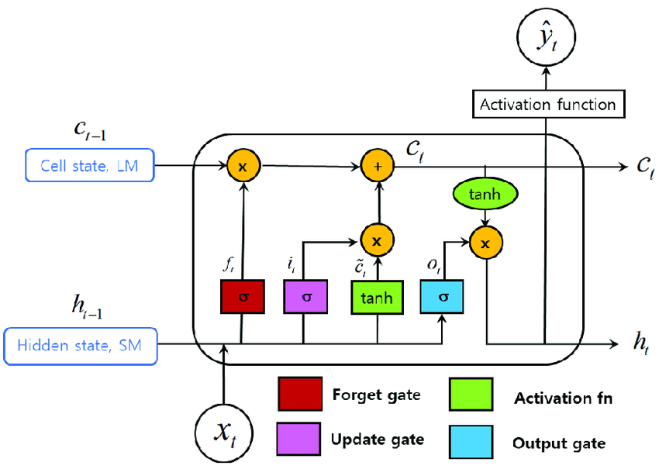
Model Architecture
Ref 3

Slide 7
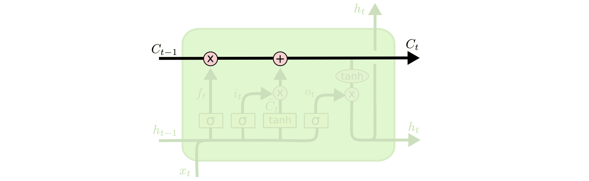
The Cell State
Memory cell: Stores information over time.
Ref 1

Slide 8
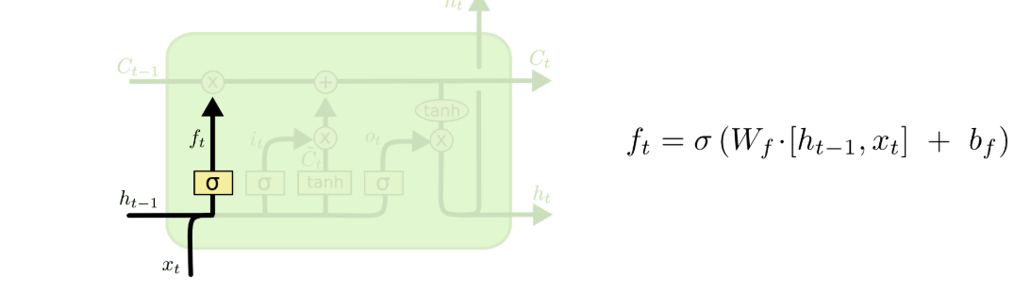
Forget Gate
Forget gate: decides which existing information is discarded from the memory cell.
Ref 1

Slide 9
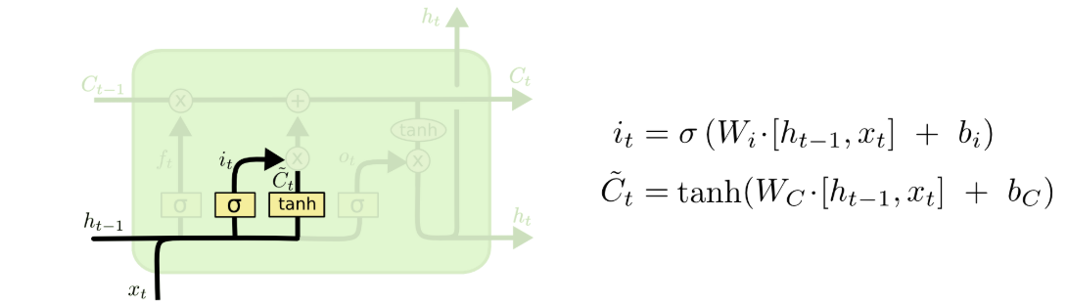
Input Gate
Input gate: regulates which new information is added into the memory cell.
Ref 1

Slide 10
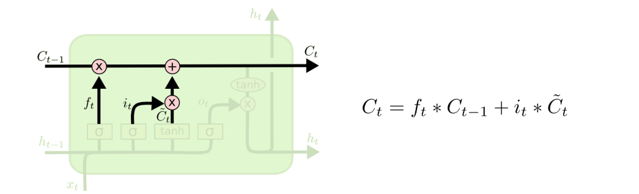
Updating the Cell State
Hidden State: Passes information to the next time step.
Ref 1

Slide 11
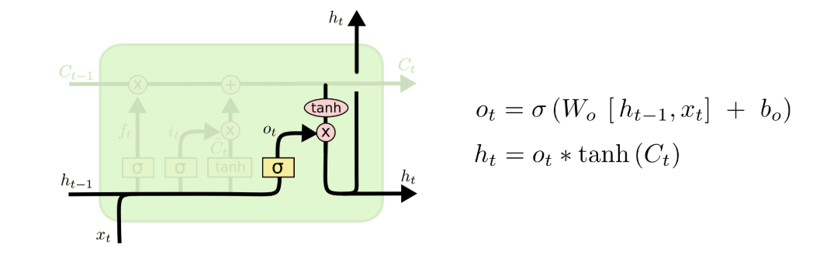
Output Gate
Output gate: manages which information is passed on as the output from the memory cell.
Ref 1

Slide 12
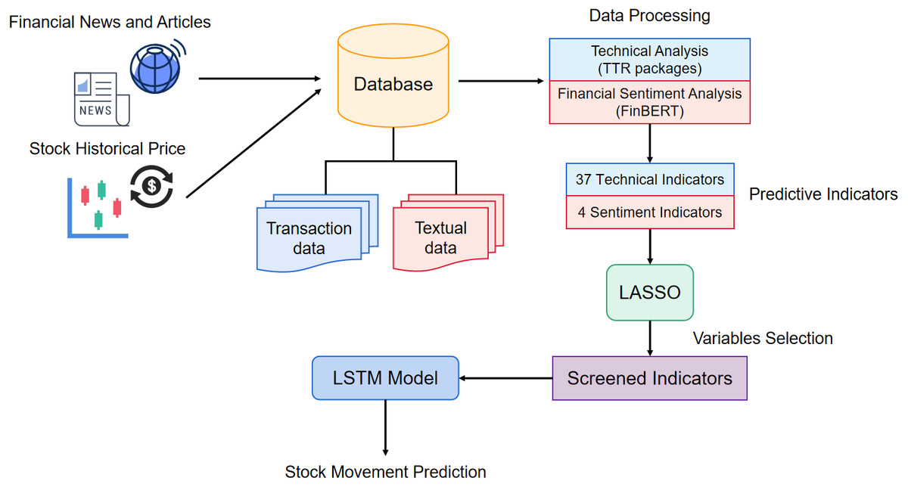
LASSO-LTSM
Ref 2

Slide 13
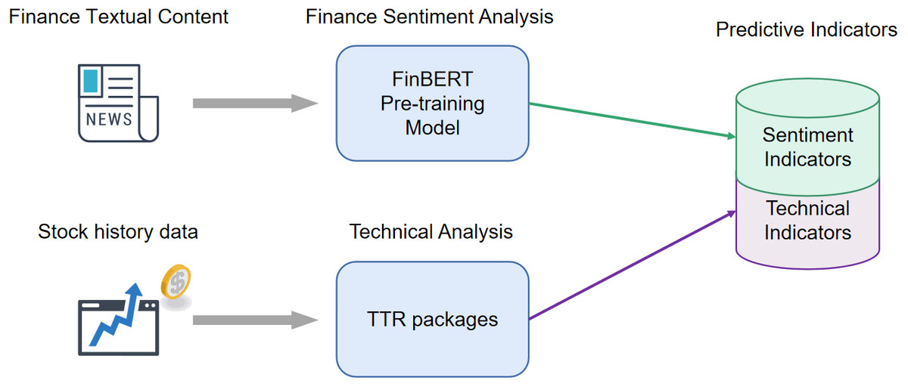
Data Processing in LASSO-LSTM
Sentiment Analysis using FinBert
Positive
Neutral
Negative
Turned into 4
Sentiment indicators
Technical Analysis using TTR
Moving Averages (MA) – Helps identify the general trend of a stock.
Relative Strength Index (RSI) – Determines if a stock is overbought or oversold.
Bollinger Bands – Measures stock price volatility.
Ref 2

Slide 14
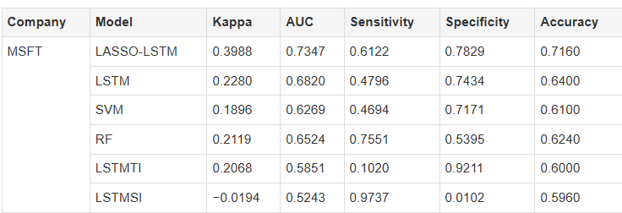
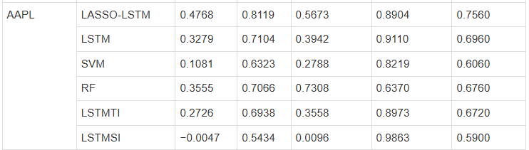
Performance of LASSO-LSTM
Ref 2

Slide 15
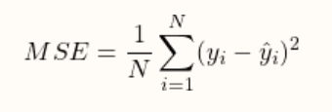
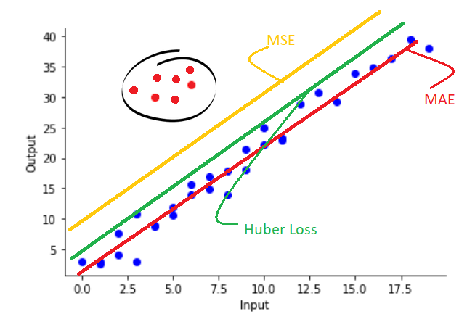

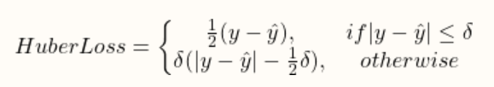
Target function and optimization
Ref 5

Slide 16
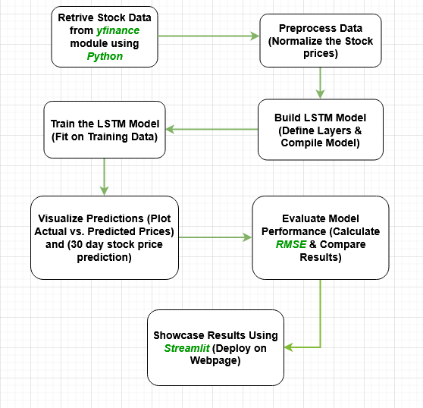
LSTM Stock Price Prediction Workflow

Slide 17
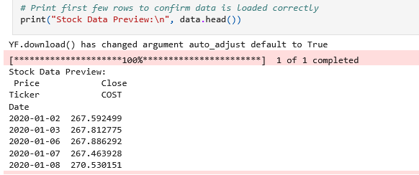
Dataset Source
The dataset is historical stock price data for the provided ticker symbol.
Data is fetched using the yfinance library, which retrieves stock data from Yahoo Finance.
The dataset starts from January 1, 2020, and ends on the current date when the code is executed.
In this model, we only focus on the close price for the stock each valid day.

Slide 18
Effect and tuning parameters
Learning Rate
Batch Size
Amount Of Layers
Keywords
Learning Rate: is a hyperparameter that controls the step size at which the model updates its weights during training
Batch Size: The number of samples the model processes before updating its weights.
Epochs: The number of times the model goes through the entire dataset.
RMSE: Root Mean Squared Error measures the average difference between actual and predicted values, providing a quantitative assessment of model accuracy. Lower RMSE is better.

Slide 19
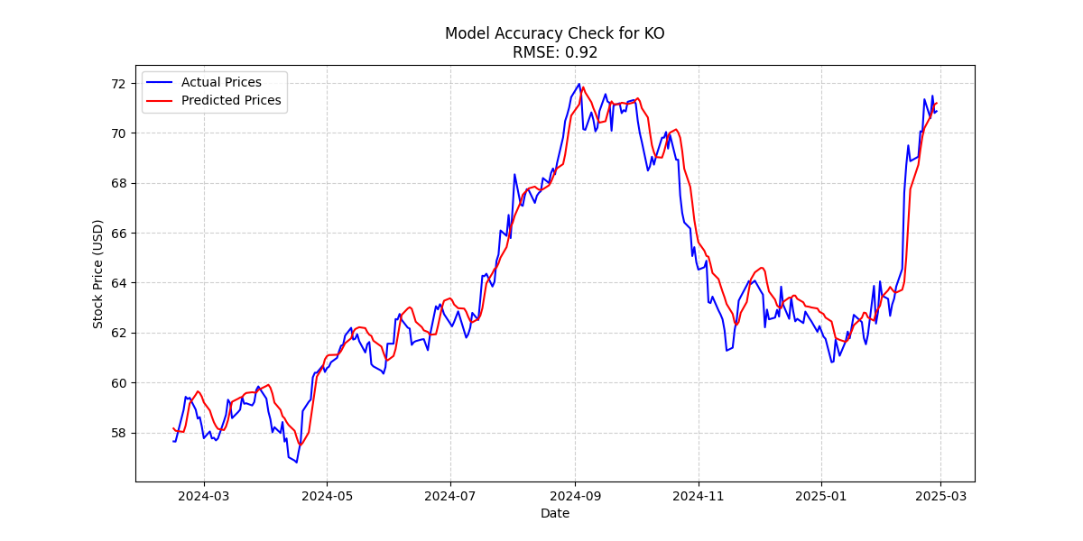
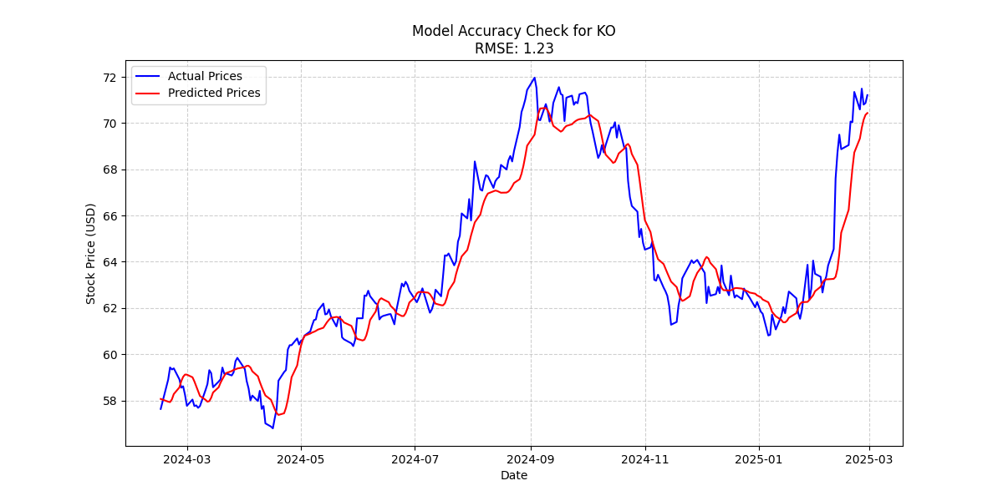
Learning Rate
Default Settings
Learning Rate: 0.001 (Default in Adam optimizer)
Number of LSTM Layers: 2
Epochs: 50
Batch Size: 32
Modified Configuration (Lowered Learning Rate)
Learning Rate Lowered To: 0.0005
Number of LSTM Layers: 2 (Unchanged)
Epochs: 50 (Unchanged)
Batch Size: 32
Lowering the learning rate to 0.0005 slowed convergence, preventing the model from fully learning stock price patterns within 50 epochs, leading to underfitting. The smaller updates caused less responsiveness to market fluctuations, reducing prediction accuracy. As a result, RMSE increased from 0.92 to 1.23

Slide 20

Batch Size
Default Settings
Learning Rate: 0.001 (Default in Adam optimizer)
Number of LSTM Layers: 2
Epochs: 50
Batch Size: 32
Modified Configuration (Higher Batch Size)
Learning Rate: 0.001 (Default in Adam optimizer)
Number of LSTM Layers: 2 (Unchanged)
Epochs: 50 (Unchanged)
Batch Size: 64
Increasing the batch size from 32 to 64 led to a higher RMSE (0.92 → 1.21), indicating a slight drop in accuracy. The larger batch size made training smoother but reduced the model's ability to capture fine stock price fluctuations. This suggests that batch size = 32 provides better generalization for this dataset.

Slide 21
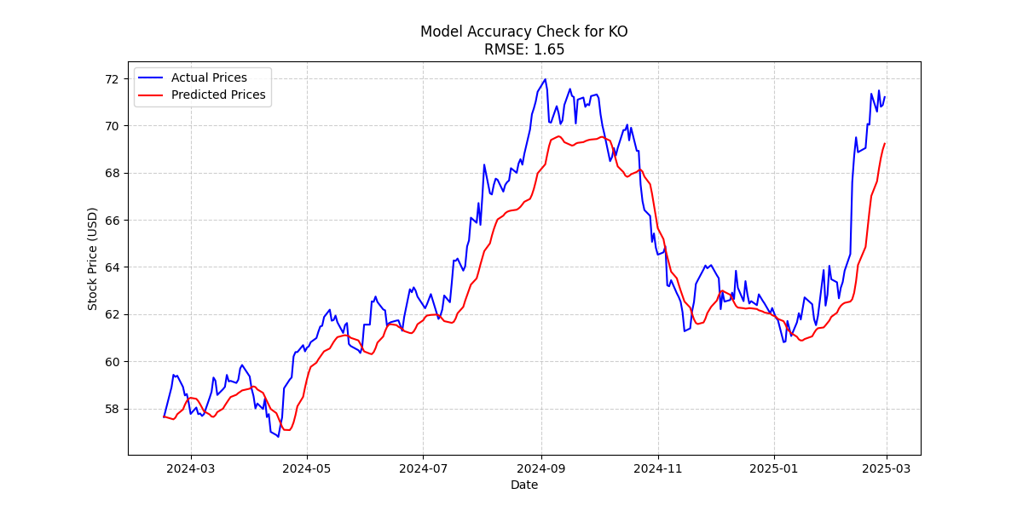
Amount of Layers
Default Settings
Learning Rate: 0.001 (Default in Adam optimizer)
Number of LSTM Layers: 2
Epochs: 50
Batch Size: 32
Modified Configuration (Extra Layer)
Learning Rate: 0.001 (Default in Adam optimizer)
Number of LSTM Layers: 3
Epochs: 50 (Unchanged)
Batch Size: 32
Adding an extra LSTM layer increased RMSE from 0.92 to 1.65, reducing model accuracy. The deeper network may have overfitted or struggled to generalize stock price patterns effectively.

Slide 22
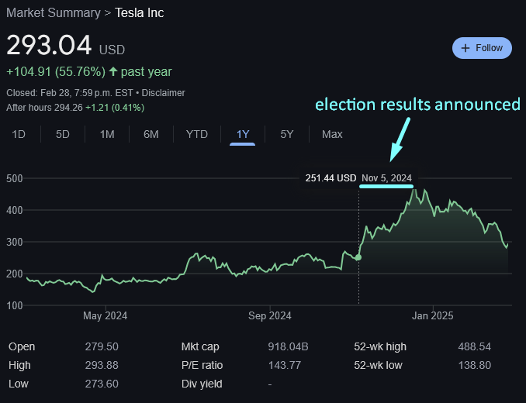
Limitations of Using LSTM for Stock Price Prediction
Prone to Overfitting – LSTM models can memorize patterns in historical stock data but struggle with generalizing to unseen market conditions.
Limited Ability to Capture External Factors – Stock prices are influenced by news, economic policies, and global events, which LSTMs do not inherently process
Market Volatility and Noise – Highly volatile stocks, such as tech stocks (e.g., Microsoft, Nvidia, or Apple), experience rapid price swings due to earnings reports, innovations, or regulatory news, making it difficult for LSTMs to distinguish real trends from short-term fluctuations.
Computationally Expensive – Training LSTMs on large datasets requires significant computational power and time

Slide 23
Sources
Ref 1:https://colah.github.io/posts/2015-08-Understanding-LSTMs/
Ref 2:https://peerj.com/articles/cs-1148/
Ref 3: https://www.researchgate.net/figure/Diagram-of-LSTM-cell-structure-operations-are-marked-by-yellow-color_fig1_369108433
Ref 4:https://www.geeksforgeeks.org/deep-learning-introduction-to-long-short-term-memory/
Ref 5: https://datamonje.com/regression-loss-functions/
Ref 6: https://medium.com/@sprhlabs/understanding-deep-learning-dnn-rnn-lstm-cnn-and-r-cnn-6602ed94dbff

